Slide 1
Congenital X-linked nystagmus and FRMD7
Kristen Klimo
http://klimogen677s12.weebly.com/

Slide 2
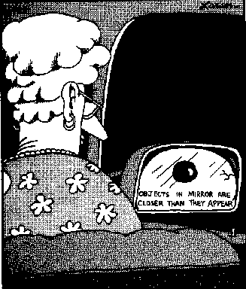
What is Nystagmus?
Congenital
Late-onset
Disease associated
1.9/1000 people worldwide
http://www.fraternalorderofmoai.org/huimalu/viewtopic.php?f=9&t=13034

Slide 3
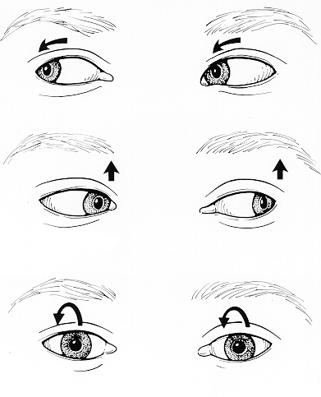
Symptoms and Treatment
Rapid, irregular eye movement
Abnormal tilting of the head
No curative treatment
Null point
Surgery
http://ivertigo.net/vertigo/verdiagnosis.html

Slide 4
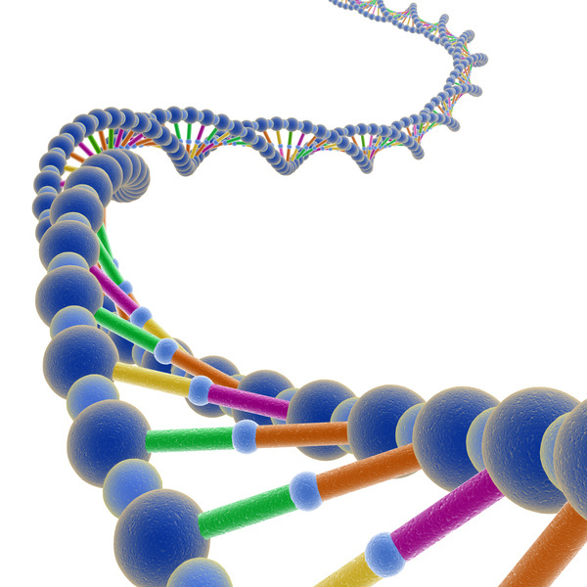
Tricky Genes
Five genes
Autosomal and X-linked
Dominant and recessive
http://photo-dictionary.com/phrase/644/DNA.html#b

Slide 5
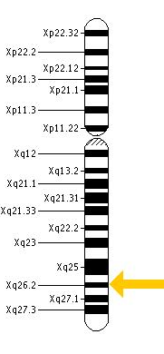
FRMD7
12 exons
Motor neurons
X-Inactivation
http://ghr.nlm.nih.gov/gene/FRMD7
Thomas, M. G., et. al. The clinical and molecular genetic features of idiopathic infantile periodic alternating nystagmus. Brain, a Journal of Neurology,
2011(134), 892, doi: 10.1093/brain/awq373

Slide 6
Human
Mouse
Dog
Chicken
Cattle
Fly
C. elegans

Slide 7
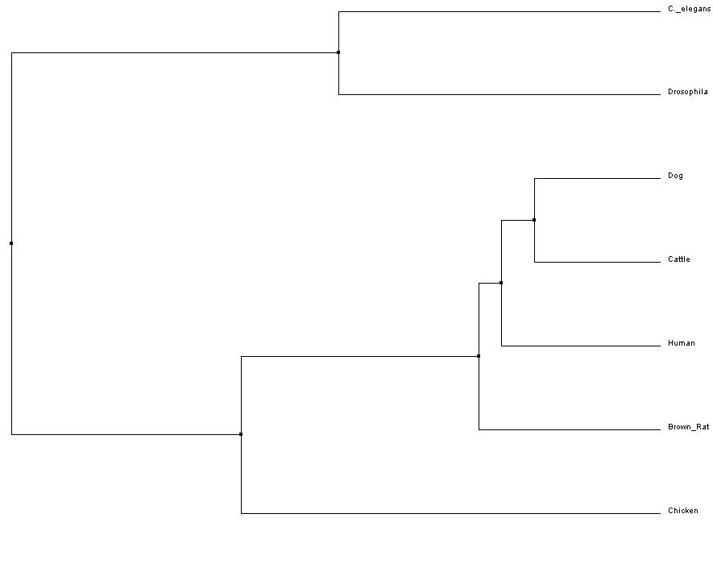
No Eyes
Compound Eyes
Simple Eyes

Slide 8
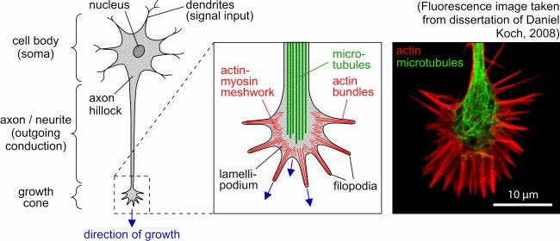
Growth Cone
http://www.uni-leipzig.de/~pwm/web/?section=introduction&page=neurons

Slide 9
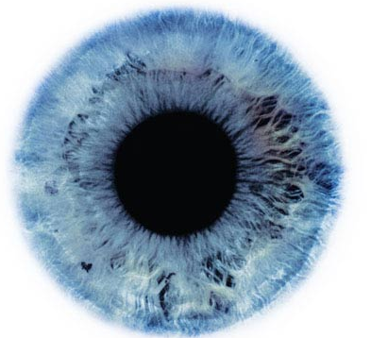
To date, there isn’t a lot of information about FRMD7’s roles in the cell. We need to gain a better understanding of its normal functions and interactions.
http://www.nuacco.com/2007/12/27/beauty-is-in-the-eye-of-the-beholder/

Slide 10
Question 1:
If FRMD7 is involved with growth cone formation, what other cytoskeleton proteins does it interact with?

Slide 11
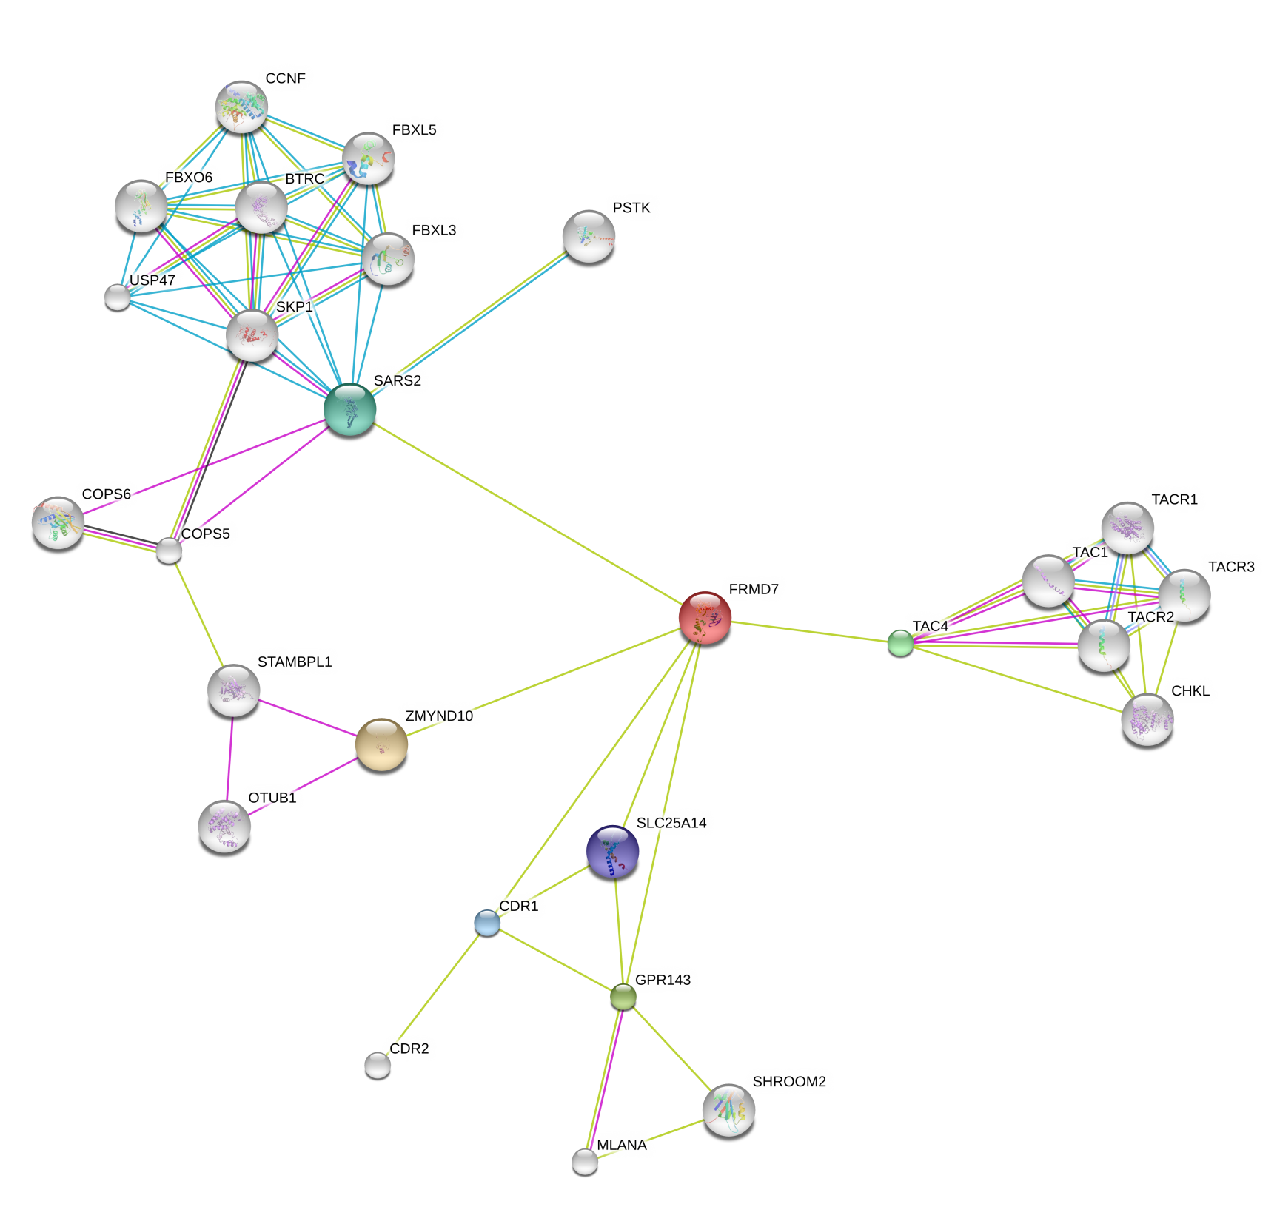

Slide 13
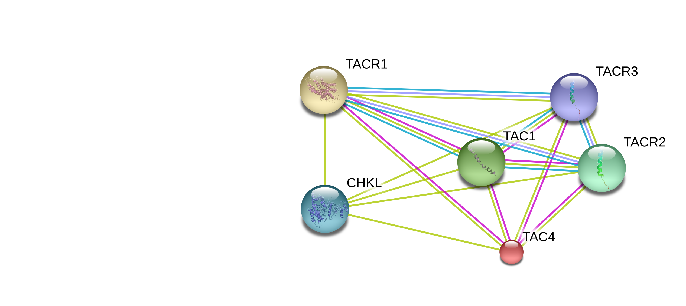
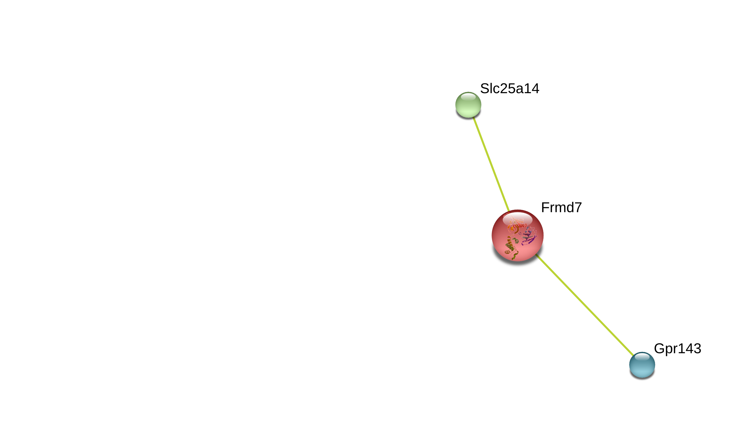

Slide 15
Hypothesis
Since the TAC complex is full of proteins that excite neurons, including those involved in muscle contraction and calcium secretion, this complex interacts with FRMD7 during axonal growth cone formation.

Slide 16
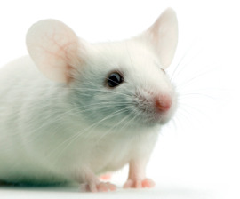
Mouse Model
http://www.humanesociety.org/news/news/2009/02/too_fixated_on_mice_022009.html

Slide 17
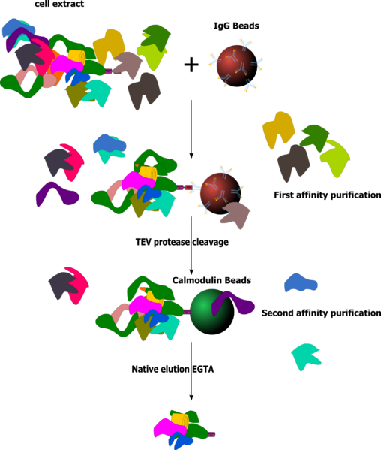
Experiment 1
TAP tags
MudPit
http://en.wikipedia.org/wiki/File:Taptag_simple.png

Slide 18
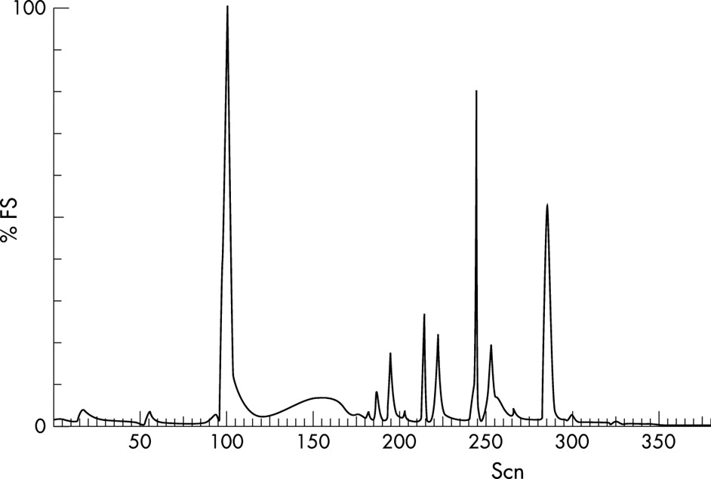
Expected Results
All proteins in TAC complex, including FRMD7 pull down each other
http://www.pnas.org/content/100/13/7644/F3.expansion.html

Slide 19
Question 2:
Are FRMD7 and TAC4 co-localizing in the motor neuron cells, or do they simply interact briefly?

Slide 20
Hypothesis
If TAC4 and FRMD7 are able to pull down each other in the Tap Tag/MudPit analysis, they most likely co-localize in the mouse embryo motor neuron cells for more than a brief period of time.

Slide 21
Experiment 2
FRMD7
TAC4
Screen for FRMD7
Screen for TAC4
Merge

Slide 22
Culture Cells
Adapted from: http://www.molecularstation.com/dna/cdna-library/

Slide 23
Culture Cells
Cell
Adapted from: http://www.molecularstation.com/dna/cdna-library/

Slide 24
Cell
RNA
Culture Cells
Adapted from: http://www.molecularstation.com/dna/cdna-library/

Slide 25
Cell
RNA
Culture Cells
Reverse Transcriptase
Adapted from: http://www.molecularstation.com/dna/cdna-library/

Slide 26
Cell
RNA
Culture Cells
Reverse Transcriptase
DS cDNA
Adapted from: http://www.molecularstation.com/dna/cdna-library/

Slide 27
Cell
RNA
Culture Cells
Reverse Transcriptase
DS cDNA
Bacterial Plasmid
Adapted from: http://www.molecularstation.com/dna/cdna-library/

Slide 28
Cell
RNA
Culture Cells
Reverse Transcriptase
DS cDNA
Bacterial Plasmid
Bacterial Cells
Adapted from: http://www.molecularstation.com/dna/cdna-library/

Slide 29
Cell
RNA
Culture Cells
Reverse Transcriptase
DS cDNA
Bacterial Plasmid
Bacterial Cells
Adapted from: http://www.molecularstation.com/dna/cdna-library/

Slide 30
Cell
RNA
Culture Cells
Reverse Transcriptase
DS cDNA
Bacterial Plasmid
Bacterial Cells
Adapted from: http://www.molecularstation.com/dna/cdna-library/

Slide 31
Adapted from: http://www.molecularstation.com/dna/cdna-library/

Slide 32
Mouse ES Cells
Adapted from: http://www.molecularstation.com/dna/cdna-library/

Slide 33
Mouse ES Cells
Select for cells tagged with fluorophore
Adapted from: http://www.molecularstation.com/dna/cdna-library/

Slide 34
Mouse ES Cells
Select for cells tagged with fluorophore
http://www.humanesociety.org/news/news/2009/02/too_fixated_on_mice_022009.html
Adapted from: http://www.molecularstation.com/dna/cdna-library/

Slide 35
Mouse ES Cells
Select for cells tagged with fluorophore
Select offspring for tagged gene
http://www.humanesociety.org/news/news/2009/02/too_fixated_on_mice_022009.html
Adapted from: http://www.molecularstation.com/dna/cdna-library/

Slide 36
Mouse ES Cells
Select for cells tagged with fluorophore
Select offspring for tagged gene
Mate heterozygous offspring to produce homozygous KI strain
http://www.humanesociety.org/news/news/2009/02/too_fixated_on_mice_022009.html
Adapted from: http://www.molecularstation.com/dna/cdna-library/

Slide 37
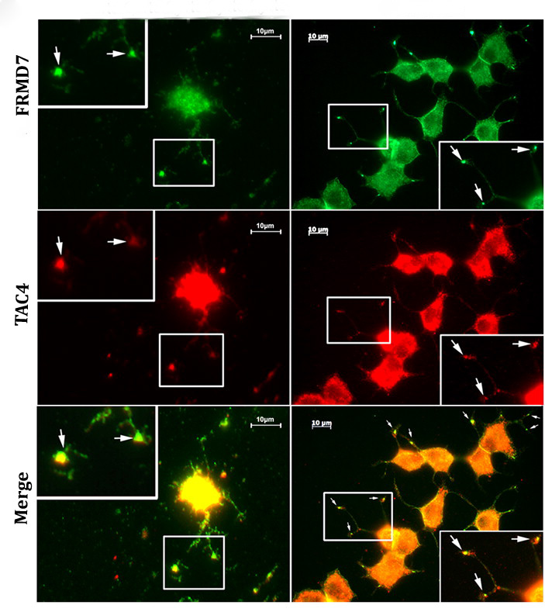
Expected Results
http://www.pnas.org/content/107/6/2658/F4.expansion.html

Slide 38
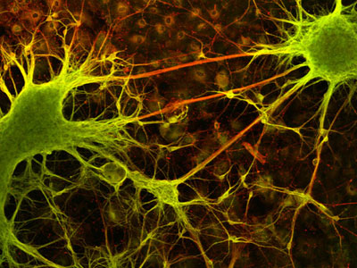
Summary
TAC complex interacts with FRMD7 in mice
TAC4 and FRMD7 co-localize in the neuronal cells, especially the growth cone
http://www.nikonsmallworld.com/gallery/year/2004/5

Slide 39
Future Directions
Further verification of TAC complex
Colocalization experiments in mice with GFP
Experiments in C. elegans
frm-5, max-1, frm-3, frm-10, frm-4, kin-32, kri-1, frm-8
Drug discovery
Few drugs are used with poor results
Connections to other nervous system disorders
http://genomicenterprise.com/blog/2010/09/03/peer-review-of-articles-in-science-politically-correct/

Slide 40
References
Medline Plus: http://www.nlm.nih.gov/medlineplus/ency/article/003037.htm
Watkins, R., Thomas, M. G., Talbot, C. J. Gottlob, I., Shakelton, S. (2012) The role of FRMD7 in Idiopathic Infantile Nystagmus. Journal of Opthalmology, 2012(2012), 460956. doi: 10.1155/2012/460956
American Nystagmus Network: http://www.nystagmus.org/aboutn.html
Lee, J. (2002) Surgical management of nystagmus. Journal of the Royal Society of Medicine, 95(5), 238. Retrieved from: http://www.ncbi.nlm.nih.gov/pmc/articles/PMC1279676/
Self, J. E., Shawkat, F., Malpas C. T., Thomas S., Harris, C. M., Hodgkings P. R., Chen, X., Trump, D., Lotery, A. J. (2007) Allelic variation of the FRMD7 gene in congenital idiopathic nystagmus. Ophthalmic Molecular Genetics, 125(9), 1255. Retrieved from: http://archopht.ama-assn.org/cgi/content/full/125/9/1255
Thomas, M. G., Crosier, M., Lindsay, S., Kumar, A., Thomas, S., Araki, M., Talbot, C., McLean, R. J., Surendran, M., Taylor, K., Leroy, B. P., Moore, A. T., Hunter, D. G., Hertle, R. W., Tarpey, P., Langmann, A., Lindner, S., Brandner, M., Gottlob., I. (2011) The clinical and molecular genetic features of idiopathic infantile periodic alternating nystagmus. Brain, a Journal of Neurology, 2011(134), 892, doi: 10.1093/brain/awq373
Tarpey P., Thomas S., Sarvananthan N., Mallya U., Lisgo S., Talbot C. J., Roberts E. O., Awan M., Surendran M., McLean R. J., Reinecke R. D., Langmann A., Lindner S., Koch M., Jain S., Woodruff G., Gale R. P., Degg C., Droutsas K., Asproudis I., Zubcov A. A., Pieh C., Veal C. D., Machado R. D., Backhouse O. C., Baumber L., Constantinescu C. S., Brodsky M. C., Hunter D. G., Hertle R. W., Read R. J., Edkins S., O'Meara S., Parker A., Stevens C., Teague J., et. al. (2006) Mutations in FRMD7, a newly identified member of the FERM family, cause X-linked idiopathic congenital nystagmus. Nature Genetics, 38, 1242. doi: 10.1038/ng1893

Slide 41
References
Dereeper A., Audic S., Claverie J. M., Blanc G. (2010) BLAST-EXPLORER helps you building datasets for phylogenetic analysis. BioMed Central Evolutionary Biology, 2010(10:8). doi: 10.1186/1471-2148-10-8
Dereeper A., Guignon V., Blanc G., Audic S., Buffet S., Chevenet F., Dufayard J.F., Guindon S., Lefort V., Lescot M., Claverie J.M., Gascuel O. (2008) Phylogeny.fr: robust phylogenetic analysis for the non-specialist. Nucleic Acids Research. 2008(1;36) W465. doi: 10.1093/nar/gkn180
Edgar R. C. (2004)MUSCLE: multiple sequence alignment with high accuracy and high throughput. Nucleic Acids Research. 2004(32:5), 1792. doi: 10.1093/nar/gkh340
Castresana J. (2000) Selection of conserved blocks from multiple alignments for their use in phylogenetic analysis. Molecular Biology and Evolution, 2000(17), 540. Retrieved from: http://mbe.oxfordjournals.org/content/17/4/540.long
Guindon S., Gascuel O. (2003) A simple, fast, and accurate algorithm to estimate large phylogenies by maximum likelihood. Systems Biology. 2003(52), 696. doi: 10.1080/10635150390235520
Anisimova M., Gascuel O. (2006) Approximate likelihood ratio test for branchs: A fast, accurate and powerful alternative. Systems Biology. 2006(55), 539. doi: 10.1080/10635150600755453
Felsenstein J. (1989) PHYLIP - Phylogeny Inference Package (Version 3.2). Cladistics, 1989(5), 164. Retrieved from: http://www.citeulike.org/user/rvosa/article/2346707
Betts-Henderson J., Bartesaghi, S., Crosier, M., Lindsay, S., Chen, H., Salomoni, P., Gottlob, I., Nicotera P. (2010) The nystagmus-associated FRMD7 gene regulates neuronal outgrowth and development. Human Molecular Genetics, 19(2), 342. doi: 10.1093/hmg/ddp500

Slide 42
Questions?
http://klimogen677s12.weebly.com/

